Slide 1
Ad-hoc analytics on top of data
Using this monthly data solves some ad-hoc analytics questions
As per our data dictionary of dataset in the organization
Extract this business findings
Calculate the total amount generated this month
Total trips done in this month
What is total fare amount collected
Calculate tip amount
Tolls amount collected and paid at the time
Calculate Mta tax collected

Slide 2
The "MTA tax" typically refers to a tax associated with the Metropolitan Transportation Authority (MTA) in the state of New York
Trips done by both vendors and there percentage
Calculate improvement surcharge
Calculate trips done by using different rate code type
Calculate payments done by different options
All these analytics helps to stakeholders to understand about the data
They will further dig deep into it and take effective decisions on their business

Slide 3
After connecting with data
making a star schema
we will write Dax queries to get measures as answers to query
All the Dax code is available in 7-dax code of power bi

Slide 4
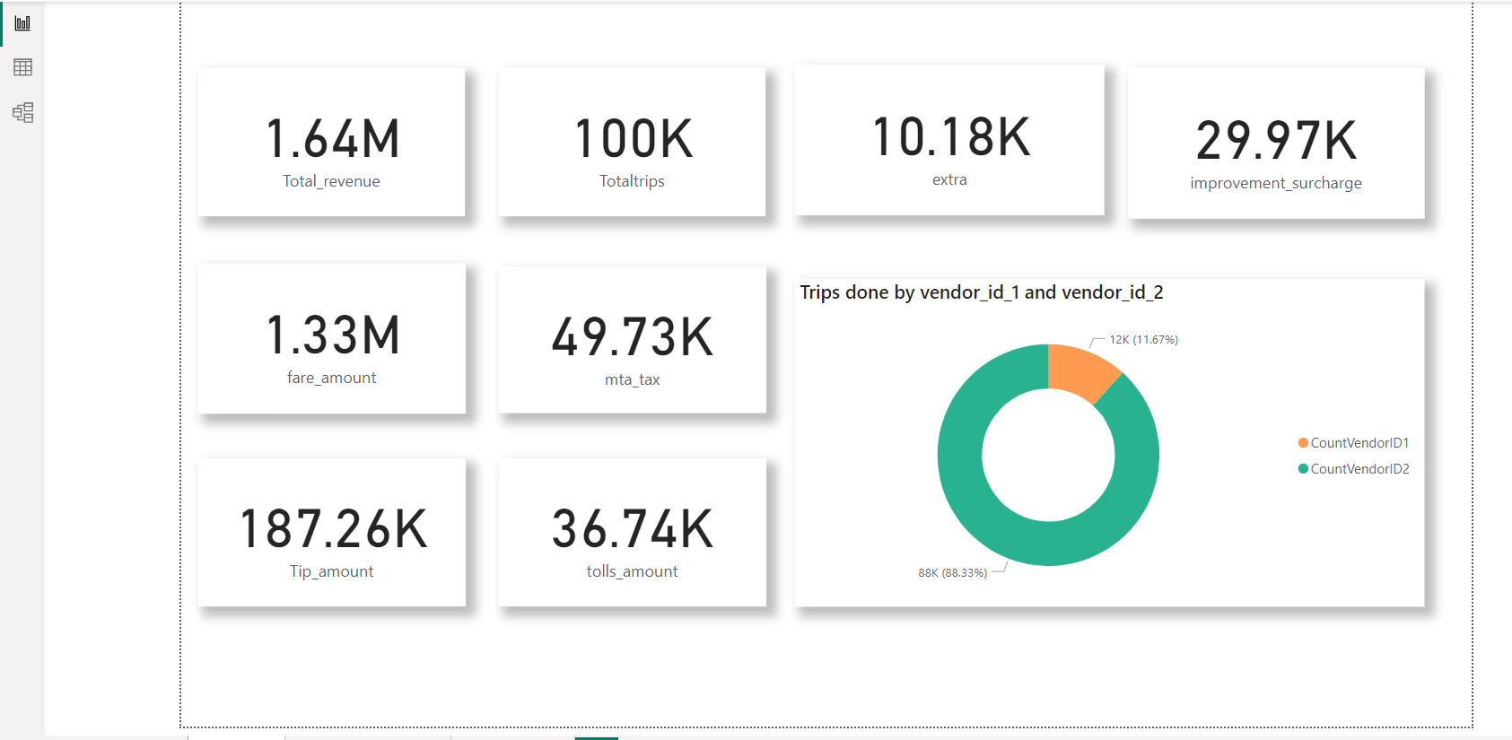

Slide 5
BY looking at the page
We can understand that mostly trips done by vendor 1
Tip amount shows the relationship with driver and passenger is good through the ride
Rides are effective and happy
Total amount revenue generated 1.66M
From that total fare amount is 1.33M

Slide 6
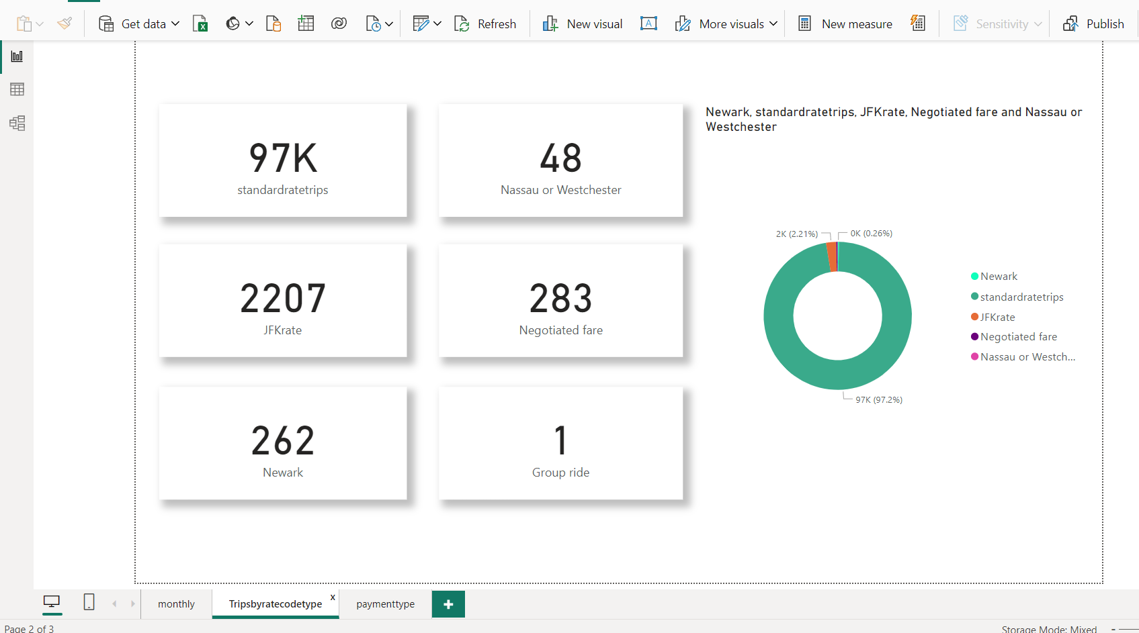

Slide 7
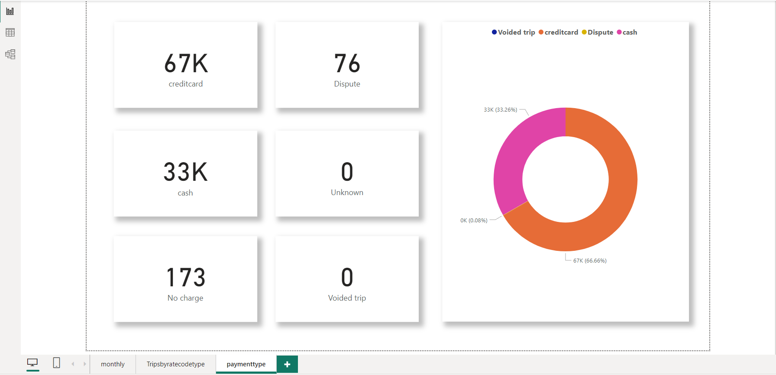

Slide 8
Mostly we can say that 70% of rides payment done by credit card
It shows that we have to look at financial data to understand our most customers use which brand of credit card
We can deal with them to make a offer of our customers
In special occasion by offering discounts make our rides double and increase some profit also.

